Slide 1
Paging
The Intel Microprocessors 8th Edition by Barry B Brey
2-4 Memory paging page 68
17-6 The memory paging mechanism page 713
Advanced microprocessors and peripherals Chapter 10
Protected Mode Memory Management by Yariv Kaplan
Arnab Bhattacharjee
Lecturer, Department of CSE,
United International University
Email id : arnab@cse.uiu.ac.bd
Courtesy: Nasif M. Sir,
Md. Shafqat Talukder Rakin Sir

Slide 2
2–4 MEMORY PAGING
The memory paging mechanism allows any physical memory location to be assigned to any linear address.
Iinear address is defined as the address generated by a program.
Physical address is the actual memory location accessed by a program.
With memory paging, the linear address is invisibly translated to any physical address.

Slide 3
Paging technique (1)
Paging is one of the memory management techniques used for virtual memory multitasking operating system.
The segmentation scheme may divide the physical memory into a variable size segments but the paging divides the memory into a fixed size pages.
The pages are just fixed size portions of the program module
or data.

Slide 4
Paging technique (2)
Main Memory
The operating system uses page tables to map the pages in the linear virtual address space onto main memory
Page m
. . .
Page n
linear virtual address space of Program 1
. . .
. . .
linear virtual address space of Program 2
Page 2
Page 2
Page 1
Page 1
Page 0
Page 0
Hard Disk
The operating system swaps pages between memory and the hard disk
Each running program has its own page table
Pages that cannot fit in main memory are stored on the hard disk
As a program is running, the processor translates the linear virtual addresses onto real memory (called also physical) addresses

Slide 5
What is a Page Table?
• The page table is a data structure used by the Operating System (OS) to map virtual addresses to physical addresses.
• Each virtual page has an entry in the page table that tells which physical frame it is stored in.
• This mapping enables virtual memory systems to run large programs efficiently.

Slide 6
Where Does the Page Table Reside?
• Main Memory (RAM): The full page table is typically stored in RAM.
• MMU (Memory Management Unit): A CPU component that accesses the page table during address translation.
• TLB (Translation Lookaside Buffer): A cache inside the CPU that stores recently used page table entries to speed up address translation.

Slide 7
Paging technique (3)
Paging divides the linear address space into fixed-sized blocks called pages (4 KB page).
Operating system allocates main memory for pages
  Pages can be spread all over main memory
  Pages in main memory can belong to different programs
  If main memory is full then pages are stored on the hard disk
OS has a Virtual Memory Manager (VMM)
  Uses page tables to map the pages of each running program
  Manages the loading and unloading of pages

Slide 8
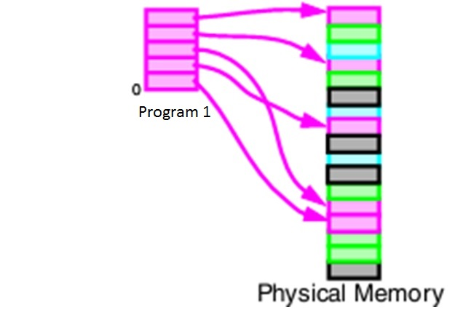
Paging technique (4)

Slide 9
Paging technique (5): Virtual Memory
Linear Virtual Address
Primary Memory
2 GB
Physical
memory
16 MB
Page 0
Page 1
Page x
….
Page 1
Page x
Secondary Storage
Hard Disk 2 GB
Page n
Page 0
Not Allocated Yet

Slide 10
Example Question
Suppose there are total 32 virtual pages.
  Each page table entry size = 16 Bytes
Size of Page Table = 128 Bytes
How many pages will be stored in primary memory?

Slide 11
Solution
Page Table reside in primary memory.
There could be 128 bytes/16 bytes pages stored in the page table
So, 8 pages out of 32 pages are stored in the primary memory.

Slide 12
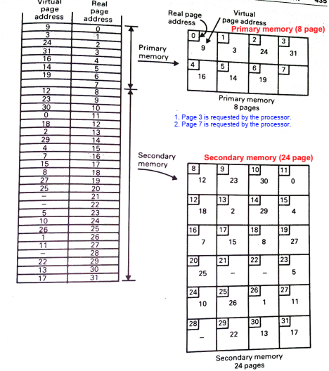
Observation:
Some virtual pages are not assigned (not used). Real page 7, the last Page in the Primary memory is currently free.
1st task: Page 3 is requested by the processor
First, hardware is activated to check whether the page is in the Primary memory. The hardware finds the page currently residing in real page 1 and the page can be referenced.
2nd task: Next, Page 7 is requested by the processor
Suppose, virtual page 7 is now requested by the processor. The hardware checks that the page is not currently residing in the Primary memory. Then, a software mechanism is activated to search for the location in the Secondary memory. The page is transferred into the free real page 7 in Primary memory and subsequently referenced by the processor. The page translation table is updated.
3rd task: Next, Page 15 is requested by the processor
Exercise : Do it yourself.
Example Paging

Slide 13
Advantage of Paging technique
The advantage of paging scheme is that the complete segment of a task need not be in the physical memory at any time.
  Only a few pages of the segments, which are required currently for the execution need to be available in the physical memory. Thus the memory requirement of the task is substantially reduced, relinquishing the available memory for other tasks. Whenever the other pages of task are required for execution, they may be fetched from the secondary storage.
Thus paging mechanism provides an effective technique to manage the physical memory for multitasking systems.

Slide 14
Page fault
If the page required by the processor is not in the main memory, then page fault occurs.
The OS then reads the page from disk and puts in the RAM.
The OS then changes the Page Table to map the new page.

Slide 15
Thank You

